Slide 1
Context Aware Guest Experience Agent using MCP
Presented by: Navya Bansal

Slide 2
Objectives:
Build a real-time, context-aware guest experience agent for hotels using the Model Context Protocol (MCP).
Improve service quality, customer retention, up-selling, cross-selling, and gather actionable guest feedback efficiently.
Utilize diverse contextual inputs—booking details, guest profile, social behavior, social media, and buying patterns.
Personalize guest experiences such as check-in, room setup, relevant service offers, and support interactions
Analyze and learn from data across multiple visits for continuous improvement in personalized service delivery

Slide 3
Contextual Data Parameters of Importance
User (Guest) Interaction Layer
User (Hotel Staff) Interaction Layer
Model Context Protocol Layer
Current context of the data
AI based psychographic profiling
AI based Spent profiling
Booking Info
Guest Profile
Buying Pattern
Name,
Language,
Country of Origin,
Loyalty Status:
‘Gold’, ’Silver’, ‘Bronze’, ‘New’,
Preferences:
‘Beverages’, ‘Allergies’, ‘Room Type’, ‘Locational preference’, ‘Food preferences’, ‘color preferences’, ’musical preferences’, ‘Travel car preferences’, ‘cleanliness’
Past stays
‘Dates’, ‘Rooms’, ‘Facilities availed’,
Behavior:
‘Feedback and issues’
‘Specific Events’
Service Requests:
‘Specific Requests’, ‘Travel patterns’, ‘Any specific timings preferred for moving in and out’
Purpose of visit:
‘Business’, ‘Leisure’
Room type and category, location
Dates
Facilities booked:
‘Pick-up and drop’, ’Travel’

Slide 4
Customer Pain Points Solved by This Application
Lack of Personalization: Guests often receive generic service, missing out on experiences tailored to their preferences and history.
Fragmented Information: Traditional hotel systems force customers to repeat details, with booking, profile, and preferences stored in disconnected places.
Slow and Impersonal Service: Guests endure delays or canned responses when making requests or seeking information.
Noisy/Irrelevant Suggestions: Upselling is rarely targeted, often promoting irrelevant upgrades or offers.(The offers are generic)
Repetitive Introductions at Each Stay: Frequent guests must continually reintroduce preferences, allergies, or special requests.
Poor Handling of Feedback and Issues: Guest frustrations and compliments frequently go unnoticed or unresolved.

Slide 5
How is this application better than existing ones?
Delivers AI-powered personalized service: Recommends rooms and amenities using each guest’s habits, preferences, and feedback.
Centralizes all hotel data and tools: Enables both staff and guests to access integrated, real-time insights—unlike fragmented legacy systems.
Automates contextual upselling: Suggests premium room upgrades and tailored offers matched to guest profiles for extra revenue.
Natural language chat interface: Allows guests and staff to make requests and manage bookings conversationally, not just via manual forms.
Learns and adapts over time: Continuously improves recommendations and service quality as data grows, unlike static hotel management tools.
Easy to extend with new tools and APIs: Modular MCP architecture allows future customizations and third-party integrations without major changes.

Slide 6
KPIs indicating Benefits:
Higher guest retention and lower customer churn ratio
Improved feedback and social media branding
Increased up selling and cross selling revenue and hit rate
Shorter Guest Response and Resolution Times: Track how quickly and effectively guest queries and issues are addressed, leading to improved overall guest satisfaction.
Analyze the average amount each guest spends during their stay, reflecting success in driving additional sales and enhancing guest experience.

Slide 7
SETUP

Slide 8
Full Workflow: Components Identified
Booking Server: Manages hotel room data, handles room availability, bookings, cancellations, and updates the main CSV record of hotel rooms.
Guest Profile Server: Loads and provides access to detailed guest profiles and history, supporting queries by ID, name, and phone number.
Context-Aware MCP Server: The main AI-driven logic hub, acting as the “Model Context Protocol (MCP)” orchestrator. It is responsible for context-aware analysis, connecting guest/room data, and producing autonomous recommendations using embedded logic.
Staff Interface: Streamlit-based client for hotel staff, integrating MCP API and allowing staff to manage bookings, guests, and room status through a chat and dashboard.
Guest Interface: Streamlit-based client for hotel guests, powered by contextual insights and natural language instructions, helping guests receive recommendations, check room availability, and carry out bookings.
Datasets: Two main CSV files (Hotel_data_updated.csv, Guest_profile_data.csv) providing storage.

Slide 9
Setup Issues faced Initially
Downloading the right model from Ollama: There were size constraints, memory limitations. I initially downloaded Llama3.1 with 7B parameters as it was one of the better models in terms of accuracy speed and data. It was performing too slow and it stopped due to memory limits. After research, I found Phi-4mini with 3.8B parameters to be the most optimal model to use.
Getting the Interface to look good with proper functionality: Getting everything in the right place, incorporating new functionality etc took time and many tries.

Slide 10
SETUP SCHEMA
Client
Data Services
Guest/Staff Interface
MCP Server
(Guest Profile Server and/or Booking Server)
CSV Data
API Gateway (MCP)
Data Storage

Slide 11
Terminology in MCP Workflow
MCP (Model Context Protocol) is used here as a middleware pattern enabling context-aware, serverless, and modular integration across the frontend interfaces (staff/guest) and backend profile/booking engines. In this architecture:
MCP is directly responsible for "connecting" the Guest Profile Server and Booking Server into a single intelligent workflow accessed by both interfaces.
MCP Server acts as an intelligent “bus” using HTTP calls to fetch and connect contextual guest & room data, process deep analysis, and respond with actionable insights or booking commands.
Tools/Methods exposed via MCP allow:
Getting deep guest profiles (with context analysis)
AI-powered recommendations
Contextual room booking with upselling
Deep guest context analysis (behaviors, loyalty prediction, etc.)

Slide 12
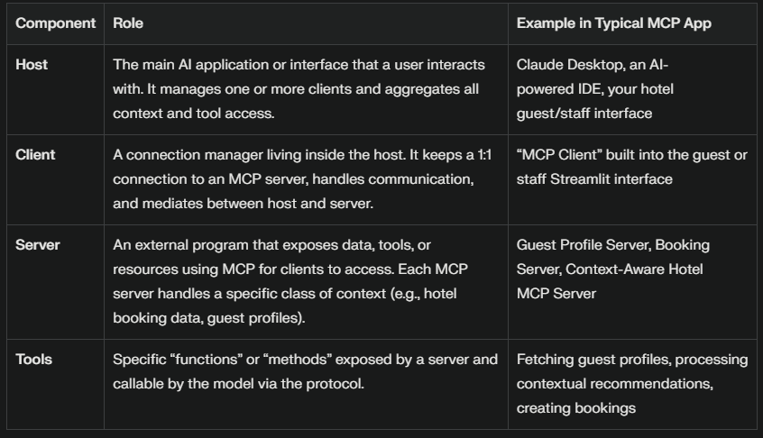
MCP acts like a “universal USB-C port for AI,” providing a standardized way for AI applications to request context, call functions, and exchange information with compatible systems

Slide 13
1. Host
Who is the host?
Both the Guest Interface (guest_interface.py) and Staff Interface (staff_interface.py) act as hosts. They are the main Streamlit applications through which users interact, and which ultimately initiate requests to MCP clients.
2. Client
Who is the client?
Each interface embeds an MCP client object/class internally (see ContextAwareSSEClient in the guest interface, and StaffClient in the staff interface). These manage the connection between the host (the UI app) and the MCP server, handling all standardized communication, tool listing, and requests.

Slide 14
3. Servers
What are the servers?
Guest Profile Server (guest_profile_server.py): An MCP-compatible server, exposes guest profile data and preference APIs.
Booking Server (booking_server.py): Another MCP “resource server,” managing hotel room data, availability, and bookings.
Context-Aware Hotel MCP Server (hotel_mcp_sse_server.py): The main MCP context server, exposing a unified set of advanced context-aware tools—such as deep guest profiling, autonomous recommendations, context-driven bookings.
4. Tools
Where are the tools defined and called?
Specific methods such as "get_contextual_guest_profile", "generate_autonomous_recommendations", "contextual_room_booking", etc., exposed in hotel_mcp_sse_server.py, are MCP tools. They are called by the Streamlit UI (client/host) via the MCP client to perform advanced, model-driven operations—such as deep analysis and intelligent booking flows

Slide 15
Detailed Schema and Flow
A. Data Layer
Guest profile data CSV: Holds all guest historical and preference data.
Hotel room data CSV: Maintains inventory, status, pricing, and metadata for rooms.
B. Service Layer
Guest Profile Server (runs on port 8001):
Loads data from Guest_profile_data.csv
Offers APIs for lookup and retrieval of guest profiles, preferences, history, loyalty status, etc.
Booking Server (runs on port 8002):
Loads hotel room information from Hotel_data_updated.csv
Offers APIs for:
Listing available/occupied/reserved rooms
Booking or cancelling rooms, including upselling logic
Updating room and guest info upon successful bookings

Slide 16
…Continued
C. Context-Aware MCP Server (AI Protocol Layer)
Role: Sits in the middle and models all contextual and autonomous logic.
How it works:
Exposes /sse endpoint for “tools/call” and “tools/list”, acting as the MCP interface.
For requests (from guest or staff interface), parses intent and fetches data from the profile or booking server as needed.
Performs deep contextual analysis using structured data (room type, guest preferences, feedback, special requests, history, loyalty, payment, etc.) to:
Generate detailed guest profiles with 360-degree insight
Make autonomous room/service/upsell recommendations
Drive intelligent booking workflows and analyze satisfaction/loyalty patterns

Slide 17
…Continued
D. Interface Layer
Guest Interface (guest_interface.py):
Used by hotel guests.
Loads guest profile (by name or phone).
Makes requests for available rooms, recommendations, or bookings.
Communicates with the MCP server for all contextual or AI-assisted operations.
Receives personalized responses and streamlined booking options based on deep contextual knowledge aggregated via MCP.
Staff Interface (staff_interface.py):
Used by hotel staff.
Allows searching/handling guest and booking data.
Connects to the MCP server for context-aware guest lookup, bookings, and profile analysis.
Provides chat-driven assistance, management dashboards, and booking/room freeing options.
Both interfaces interact with the MCP server, which in turn calls out to the backend profile and booking servers.

Slide 18
How MCP is Applied & Where
All intelligent, context-aware, and AI-powered features (recommendations, personalized insights, advanced search) are centralized in the MCP server.
It acts as the only communication endpoint for both the staff and guest UI clients for any complex or context-sensitive operation.
MCP makes HTTP calls to booking/profile services, aggregates, analyzes, and decides what to return.
Advantages:
Thin, simple client interfaces (Guest, Staff)
Centralized, maintainable business intelligence and AI logic
Plug-and-play data layer that could be swapped for different hotels or data sources

Slide 19
Room for Improvement and Upscaling:
Connecting RAG to enhance real-time data retrieval
Adding social profiles
Seamless API integration with travel partners
Automated loyalty program management
Mobile-first responsive guest app.
Dynamic pricing and yield management

Slide 20


